Slide 1


AQUILA : SEASON 4 – AN OPERATIONS CASE COMPETITION
TEAM ZION
VIDIT GARG | ADITYA KOLI | KUSHAGRA GOYAL
Shaheed Sukhdev College of Business Studies, IILM UNIVERSITY

Slide 2











INDUSTRY ANALYSIS AND TARGET AUDIENCE
Evaluating the current landscape of E-Commerce Industry in Rural and Semi Urban Areas and Customer Needs
INDUSTRY ANALYSIS
ANALYSING POTENTIAL PERSONAS AND POSITIONING
E Commerce MARKET IN INDIA
In Billions (Dollars)
MAJOR INDUSTRY PLAYERS
350
300
250
200
150
100
50
0
$325
22% expected increase
$110
Ravi, The
Remote Villager
Aarti, The
School Teacher
Santosh, A Conscious
Semi Urban Resident
Pain points
Pain points
Pain points
High Delivery cost
Concerns about payment
security
Inconsistent addressing
Unreliable Delivery Times
Delay in delivery from
Urban Centralised Stores
Product’s quality conscious
2024
2030
PORTER’S FIVE FORCES
Role of Covid in boosting E-Commerce
Growth Drivers for the Industry
Threat of new entrants Bargaining power of
suppliers
Bargaining power of customers
Threat of Substitute
Competitive Rivalry
COVID-19 accelerated India’s
E-commerce growth by 36% in 2020, with online grocery orders surging 76% and digital payments growing 25%.
Village
Infrastructure connectivity
Mobile Phone access
75%
60%
37%
v/s
Rural
FMCG Basket
Size Growth
60%
Untapped
market
Urban
Industry Analysis
Industry Analysis
Expansion Strategy
Appendix
Expansion Strategy
Timeline & Risk Mitigation

Slide 3







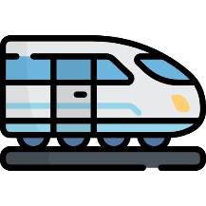
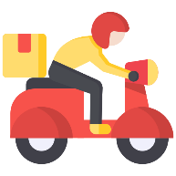








EXPANSION STRATEGY
Bridging The Gap: A Strategic Blueprint For E-Commerce Expansion
From Click to Doorstep: The Odyssey of an Order
Local delivery personnel handle the final leg, delivering packages to their destinations. Their area familiarity helps overcome language barriers, build trust, and ensure smooth deliveries.
DFCs - Dedicated Freight Corridors
Packages are transported from the seller to a central hub using DFCs trains as the main mode of transport.
DFCs are dedicated tracks for freight trains that enable higher transport capacity and faster transit times. They facilitate the running of double stack container trains and heavy haul trains, significantly improving supply chain operations for industries along these routes.
Packages from seller are grouped together based on similar delivery locations.
A centralized hub within a 30 km radius provides secure storage and sorting for packages.
Why Train is The Ideal Mode Of Transportation For Us?
SPEED: Average Speed of 60 km/hr as compared to 20km/hr of normal railway.
Parameters Of Assessment
MODE OF DELIVERY
Sustainability: DFCs can cut carbon emissions by 457 million over the next 30 years.
Cost
Efficiency
Rural Connectivity
Weather Resilience
Reduced Inventory Costs: DFCs, enable firms to streamline supply chains and faster transportation.
AIRPLANE
Trains offer the most robust delivery system that is cost efficient and more connected.
TRAIN
In summary, as Dedicated Freight Corridors are likely to transform the logistics landscape for Go-Shop helping it in efficient freight transport.
SHIP
Introduction
Expansion Strategy
Timeline & Risk Mitigation
Appendix
Industry Analysis

Slide 4
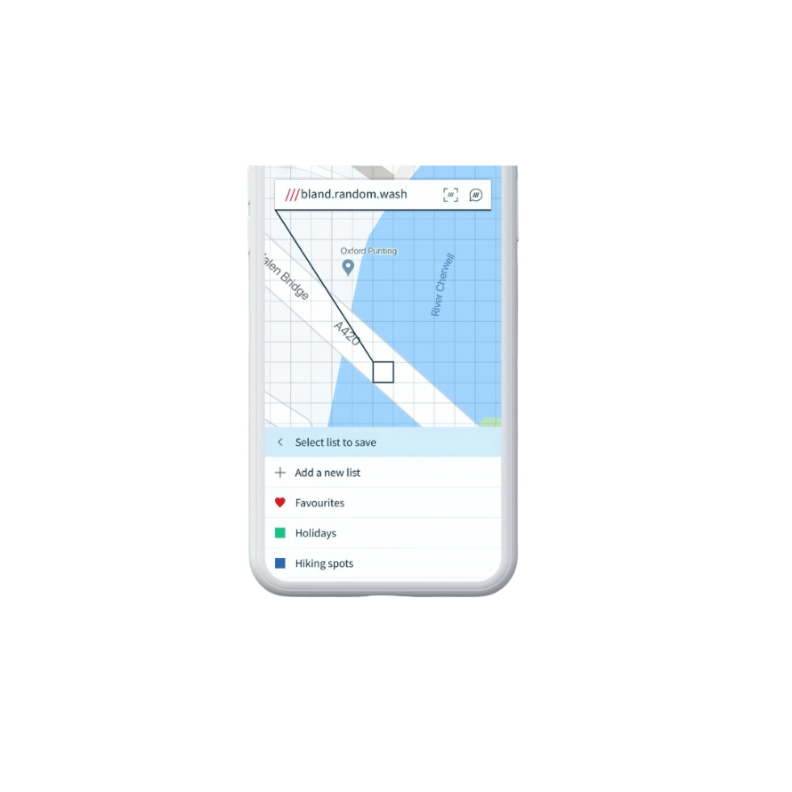




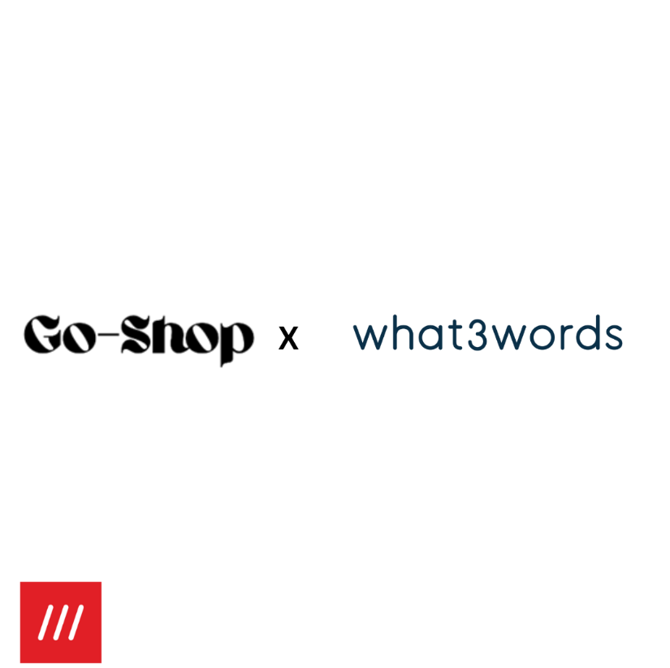




EXPANSION STRATEGY
Powering Rural E-Commerce with COD Accessibility
Nearby Semi Urban Area 1
Nearby Village 2
Our Service Providers
Each Hub is Equipped with 5 Vans, ensuring seamless transit to hubs from railways
Solving Inconsistent Addressing in Rural Areas
25KM
28KM
Powering last-mile delivery: 10 bikes at every hub for swift, reliable reach."
Centralised Hub
Special remark ; 2 Vans reserved for Big Parcels for Last Mile Delivery
Slashing Delivery Cost By 30%
31KM
30KM
Reverse Logistics
Customers initiate the return. Delivery personnel are dispatched to collect returned items. Returns are directed to the nearest hub.
Integration with what3words API to create a consistent and robust addressing systems for rural and semi-urban areas of India.
1
2
Resalable: Returned to inventory for resale.
Repairable: Sent to repair facilities or secondary sales channels.
Recyclable/Disposable: Sent to recycling or waste management facilities.
Nearby Village 3
Nearby Semi Urban Area 2
Centralised Hub
Returns are inspected at centralized hubs to determine their condition. Categories include restock-able, repairable, and unsalvageable.
Precise Location: Provides unique 3-word addresses for exact 3m x 3m locations, unlike broad pin-code areas.
Multi-Lingual: Offers addresses in multiple languages, enabling people to navigate and share locations in their preferred language, bridging linguistic gaps.
Efficient in Dense Areas: Unlike pin codes which cover up to 179 sq. km and thousands of addresses, w3w offers unique locations for better navigation in crowded regions.
2000 sq. ft
Area of Hub
Volume Of Hub
20000 Cubic ft
Order
Pay on Delivery
Return
30KM
Average Radius b/w Hub and Villages
Cash on Delivery (COD) and Pay on Delivery (POD) options are offered to build trust in India 2 and India 3 regions.
Delivery agents collect payments, which are then gathered at central hubs. Payments are transferred to sellers within 3–4 business days.
Customers may receive a bank transfer or Go Shop Credit points.
Volume Used
16000 Cubic ft
53-58 lakhs
Timeline: Refund will take about 7 – 10 business days
Cost of Construction
Introduction
Expansion Strategy
Timeline & Risk Mitigation
Appendix
Industry Analysis

Slide 5
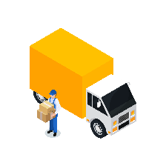
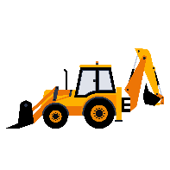
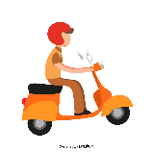
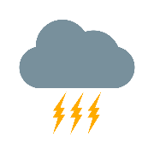
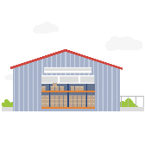
Timeline & Risk Management Phased implementation and risk resilience strategy for streamlined growth and operational continuity
TIMELINE
RISK MITIGATION
Logistics and Transportation Delays
PHASE 1
PHASE 2
PHASE 3
Partner with reliable rail services that prioritize freight and establish backup routes (e.g., using trucks) for critical times when train services may not be available.
Recycle with us Sell to us
Infrastructure and Construction Delays
Partner with reputable contractors who have experience in similar projects and have contingency plans and preemptively stockpile materials and secure supply chains to avoid delays due to shortages.
1
3
Operational Risks with Local Partners
2
Develop a strong agreement with partners to set clear expectations and regular training sessions and feedback mechanisms for local labor to ensure quality standards.
Environmental and Weather-Related Risks
Develop weather monitoring systems for predictive analysis to prepare for potential disruptions and ensure that warehouse and hub structures are designed to withstand extreme weather conditions common in the region.
GO TO MARKET STRATEGY
PHASE 1:
PHASE 2:
PHASE 3:
Setup and Initial Infrastructure
Pilot Launch & Integration
Expansion and Full Launch
Regulatory and Compliance Risks
Months 1-6
Construct Centralized Hubs
Secure Partnerships for Labor and Transport
Procure/Rent Vehicles
Months 7-18
Pilot Test in Selected High- Demand Areas
Integrate Google Maps in App for Location Tracking
Months 19-24
Open Additional Warehouses
Scale Up Operations Across Other Region
Stay updated on regulatory changes and involve legal experts for guidance on compliance and establish relationships with local regulatory bodies to gain timely insights and ensure smoother operations
Introduction
Expansion Strategy
Timeline & Risk Mitigation
Appendix
Industry Analysis

Slide 6

APPENDIX

Slide 7
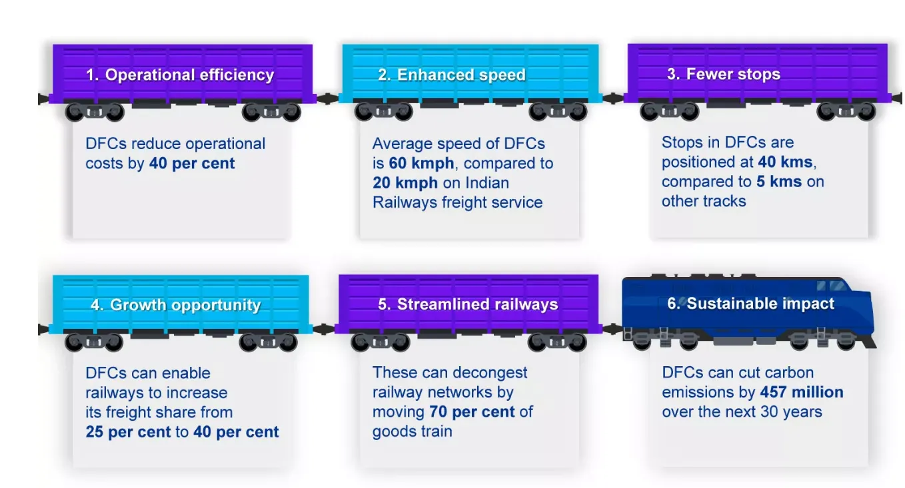

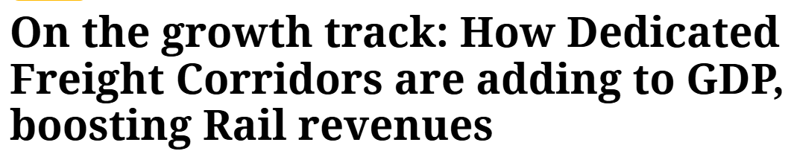
APPENDIX (1/4)
For showcasing Collaboration with Digital Freight Corridor
Speed Comparison
Operational Efficiency:
Traditional Rail Services:
The 1,337-km Eastern Dedicated Freight Corridor (EDFC) is set to enhance the operational efficiency of freight trains by enabling them to achieve top speeds of 60-70 kmph. This marks a significant improvement compared to the current operational speeds, which typically range from 25-30 kmph. Although the corridor has been designed with the capability to support a maximum speed of 100 kmph for freight trains, achieving this goal may face challenges given the current operational context.
In contrast, traditional freight trains typically operate at much lower speeds, averaging around 25 to 30 km/h. This slower pace has been a significant factor in the shift of freight transport from rail to road over the years, as consumers increasingly demand faster delivery times.
DFCs allow for faster transit times, with freight trains operating at speeds of 50-70 km/h, compared to an average of 25 km/h on conventional rail lines. This increase in speed translates into quicker deliveries, which is essential for e-commerce operations that prioritize timely service .For instance, the transit time between ports and major markets like Delhi NCR has been reduced by nearly half
1. https://indianexpress.com/article/explained/explained-economics/impact-of-indias-dedicated-freight-corridors-9651261/
Enhanced Supply Chain Efficiency:
By utilizing DFCs, e-commerce firms can streamline their supply chains, reducing inventory costs due to faster transportation times. For example, the transit time from coal fields in Eastern India to power stations has decreased from 35 hours to 20 hours, leading to a 20-30% reduction in inventory costs for power plants.
2. https://www.amjaincollege.edu.in/transforming-the-indian-economy-the-impact-of-dedicated-freight-corridor-on-indian-railways/
3. https://www.logisticsinsider.in/speed-of-freight-trains-over-the-years/
4. https://dfccil.com/Home/DynemicPages?MenuId=3
https://indianrailways.gov.in/Railways%20report%20-%208%20Jan%202016.pdf
https://www.itln.in/railway/dedicated-freight-corridors-transforming-indias-logistics-backbone-1352140
https://dfccil.com/images/uploads/img/DFC-Press-Release_DFC-achieves-avg-speed-of-99.38-kmph-on-EDFC_30.05.2021_SV17.pdf
http://www.financialexpress.com/economy/indian-railways-roro-service-hits-infrastructure-hurdle-needs-structural-change-to-work-effectively/613896/
https://indianexpress.com/article/explained/explained-economics/impact-of-indias-dedicated-freight-corridors-9651261/
https://www.financialexpress.com/business/railways-indian-railways-advances-freight-transportation-with-completion-of-eastern-dedicated-freight-corridor-and-ongoing-progress-on-western-corridor-3391026/
Appendix
Industry Analysis
Expansion Strategy
Timeline & Risk Mitigation
Appendix

Slide 8
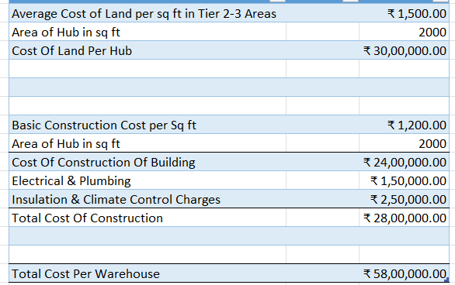
APPENDIX (2/4)
For showcasing Average cost of construction of Warehouse
Average Cost Of Construction Of Warehouse/Hub
Appendix
Industry Analysis
Expansion Strategy
Timeline & Risk Mitigation
Appendix

Slide 9
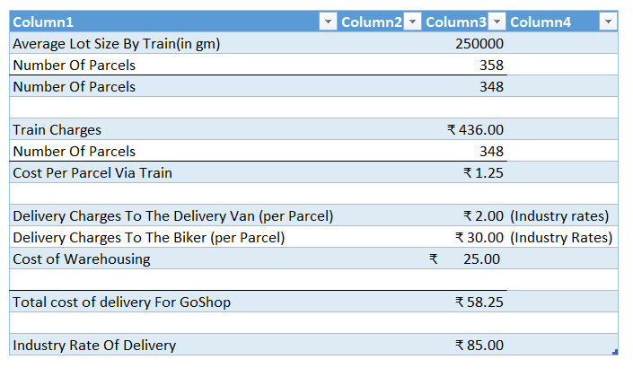
APPENDIX (3/4)
For showcasing Delivery Cost Per Parcel
Average Delivery Cost Per Parcel
Appendix
Industry Analysis
Expansion Strategy
Timeline & Risk Mitigation
Appendix

Slide 10
APPENDIX (4/4)
For showcasing the sources (links, articles and research papers) we referred to
[1] E-commerce market to hit $325 billion by 2030, rural India to lead growth https://www.business-standard.com/industry/news/e-commerce-market-to-hit-325-billion-by-2030-rural-india-to-lead-growth-124042900284_1.html
[2] Rural India's appetite for FMCG grows by 60%; what's behind the surge? https://www.business-standard.com/industry/news/rural-india-s-appetite-for-fmcg-grows-by-60-what-s-behind-the-surge-124111101097_1.html
[3] Top Growth Trends in India's E-Commerce Industry https://blog.marketresearch.com/indian-e-commerce-growth-driven-by-internet-smartphones-digital-payments-and-rural-expansion
[4] E-Commerce Statistics For India In 2024 - Forbes https://www.forbes.com/advisor/in/business/ecommerce-statistics/
OTHER VITAL RESOURCES
Invest India, Business Standard, Statista
Reports by KPMG, BCG
10
Appendix
Industry Analysis
Expansion Strategy
Timeline & Risk Mitigation
Appendix

Slide 11

THANKYOU

